Slide 1
Welcome To Concept Of Programming

Slide 2
Java
What Is JAVA?
Java is a general-purpose, class-based, object-oriented programming language designed for having lesser implementation dependencies. It is a computing platform for application development.
History of Java Programming Language
Here are important landmarks from the history of the Java language:
The Java language was initially called OAK.
Originally, it was developed for handling portable devices and set-top boxes. Oak was a massive failure.
In 1995, Sun changed the name to "Java" and modified the language to take advantage of the burgeoning www (World Wide Web) development business.
Later, in 2009, Oracle Corporation acquired Sun Microsystems and took ownership of three key Sun software assets: Java, MySQL, and Solaris.

Slide 3
Java Features
Here are some important Java features:
It is one of the easy-to-use programming languages to learn.
Write code once and run it on almost any computing platform.
Java is platform-independent. Some programs developed in one machine can be executed in another machine.
It is designed for building object-oriented applications.
It is a multithreaded language with automatic memory management.
It is created for the distributed environment of the Internet.
Facilitates distributed computing as its network-centric.

Slide 4
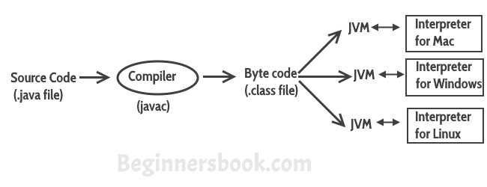

Slide 5
Language Basics
Keywords
Variables
Conditional Statements
Loops
Data Types
Operators
Coding Conventions
Notes:
A variable is an item of data named by an identifier.
You must explicitly provide a name and a type for each variable you want to use in your program. The variable's name must be a legal identifier --an unlimited series of Unicode characters that begins with a letter. You use the variable name to refer to the data that the variable contains. The variable's type determines what values it can hold and what operations can be performed on it. To give a variable a type and a name, you write a variable declaration, which generally looks like this:
type name
In addition to the name and type that you explicitly give a variable, a variable has scope. The section of code where the variable's simple name can be used is the variable's scope. The variable's scope is determined implicitly by the location of the variable declaration, that is, where the declaration appears in relation to other code elements.

Slide 6
Java Keywords
abstract | boolean | break | byte | case | catch
char | class | const | continue | default | do
double | else | extends | final | finally | float
for | goto | if | implements | import | instanceof
int | interface | long | native | new | package
private | protected | public | return | short | static
strictfp | super | switch | synchronized | this | throw
throws | transient | try | void | volatile | while
true | false | null

Slide 7
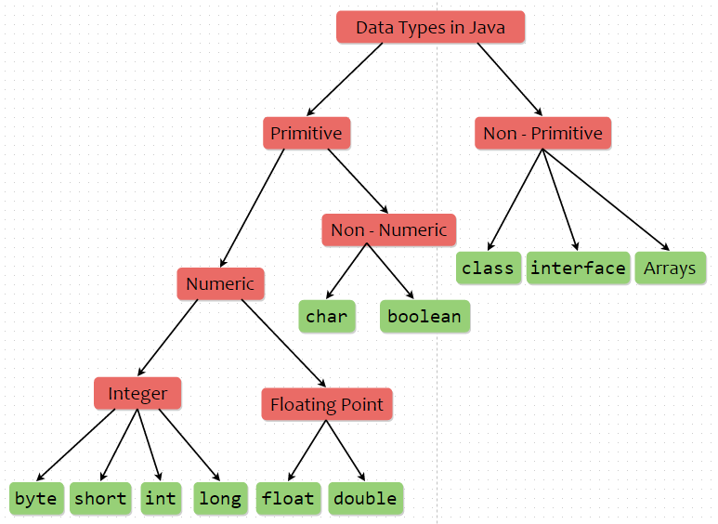

Slide 8
Data Types
Integral Type
byte 8 bits
short 16 bits
int 32 bits
long 64 bits
Textual Type
char 16 bits, UNICODE Character
String
Notes:
When you declare a variable, you explicitly set the variable's name and data type. The Java programming language has two categories of data types: primitive and reference. A variable of primitive type contains a value.
The location of a variable declaration implicitly sets the variable's scope, which determines what section of code may refer to the variable by its simple name. There are four categories of scope: member variable scope, local variable scope, parameter scope, and exception-handler parameter scope.

Slide 9
Data Types
Floating Point Type
float 32 bits
double 64 bits
Boolean Type 1 bit
true
false
Notes:
You can provide an initial value for a variable within its declaration by using the assignment operator (=).
You can declare a variable as final. The value of a final variable cannot change after it's been initialized.

Slide 10
Variables
A variable is a name given memory location. That memory is associated to a data type and can be assigned a value.
int n=90;
float f1;
char ch;
double d;

Slide 11
Variables conti…
Assigning a value to a variable
Initialization of a variable with a primary value
int n1;
n1 =21 ; // assignment
int i2 = 18; // initialization
char ch = ‘S’; // initialization
double d = 21.8; // initialization
d = n1; // assignment
float f1 = 16.13F;

Slide 12
Naming conventions
class , interfaces , enum names- 1st letter of 1st word must start with upper case & then follow camel case notation.
eg : HelloWorld
data members/methods(functions) -- 1st must start with lower case & then follow camel case notation
eg : performanceIndex
public double calculateSalary(....) {...}
constants -- all uppercase.
eg : PI

Slide 13
Rules on Identifiers
1. Identifiers must start with a letter, a currency character ($), or a connecting character such as the underscore ( _ ), cannot start with a number!
2. Can't use a Java keyword as an identifier.
3. Are Case sensitive

Slide 14
Access specifiers
private
default(package private) --no access modifier
protected
public
Legal class level access specifiers -
1. default(scope=current package only)
2. public (scope=accessible from any where)

Slide 15
Basic rules
Java compiler doesn't allow accessing of un initialized data members.
A file can have more than one non public class.
There can be only one public class per source code file.
If there is a public class in a file, the name of the file must match the nameof the public class. For example, a class declared as public class Example {....}must be in a source code file named Example.java.
Java compiler doesn't allow accessing of un-initiated vars.
eg : int n;
sop(n);//error

Slide 16
Conversions regarding primitive types
Automatic conversions(widening ) ---Automatic promotions
byte--->short--->int---> long--->float--->double
char ---> int
eg : char ch='a';
long --->float ---is considered automatic type of conversion(since float data type can hold larger range of values than long data type)

Slide 17
Rules ---
src & dest - must be compatible, typically dest data type must be able to store larger magnitude of values than that of src data type.
1. Any arithmetic operation involving byte,short --- automatically promoted to --int
2. int & long ---> long
3. long & float ---> float
4. byte,short......& float & double----> double

Slide 18
Narrowing conversion --- forced conversion(type-casting)
eg ---
double ---> int
float --> long
double ---> float

Slide 19
Basic Java Syntax Operators Control Statements

Slide 20
Primitive Types and Variables
boolean, char, byte, short, int, long, float, double etc.
These basic (or primitive) types are the only types that are not objects (due to performance issues).
This means that you don’t use the new operator to create a primitive variable.
Declaring primitive variables:
float initVal;
int retVal, index = 2;
double gamma = 1.2, brightness;
boolean valueOk = false;

Slide 21
Declarations
int data= 1.2; // compiler error
boolean flag= 1; // compiler error
double fract= 5 / 4; // no error!
float ratio = 5.8f; // correct
double fracto= 5.0 / 4.0; // correct
1.2f is a float value accurate to 7 decimal places.
1.2 is a double value accurate to 15 decimal places.

Slide 22
Assignment
All Java assignments are right associative
int a = 1, b = 2, c = 5;
a = b = c;
System.out.print(“a= “ + a + “b= “ + b + “c= “ + c);
What is the value of a, b & c
Done right to left: a = (b = c);

Slide 23
Basic Mathematical Operators
* / % + - are the mathematical operators
* / % have a higher precedence than + or –
double myVal = a + b % d – c * d / b;
Is the same as:
double myVal = (a + (b % d)) – ((c * d) / b);

Slide 24
Relational Operators
== Equal (careful)
!= Not equal
>= Greater than or equal
<= Less than or equal
> Greater than
< Less than

Slide 25
Statements & Blocks
A simple statement is a command terminated by a semi-colon:
name = “IACSD”;
A block is a compound statement enclosed in curly brackets:
{
name1 = “IACSD”; name2 = “AKURDI”;
}
Blocks may contain other blocks

Slide 26
Flow of Control
Java executes one statement after the other in the order they are written
Many Java statements are flow control statements:
Conditional Stmt: if, if else, switch
Looping: for, while, do while
Escapes: break, continue, return

Slide 27
if Statement – different syntax options
if (expression)
statement;
A single statement.
if (expression)
{
statements;
}
A block of statements.
if (expression)
statement;
else
statement;
Single statement in the if and a single statement in the else.
if (expression)
statement;
else
{
statements;
}
A single statement in the if and a block
of statements in the else.

Slide 28
Conditional Operator
The operator “ ? : ” is the only operator that takes three operands, each of which is an expression.
The value of the whole expression equals the value of expr2 if expr1 is true, or equals the value of expr3 if expr1 is false.
Syntax:
expr1 ? expr2 : expr3

Slide 29
switch Statement
The nested if can become complicated and unreadable.
The switch statement is an alternative to the nested if.
Syntax: switch(expression) { case constant expr: statement(s); [break;] case constant expr: statement(s); [break;] case constant expr: statement(s); [break;] default : statement(s); [break;] }
Usually, but not always, the last statement of a case is break.
default case is optional.
Notes:
altered

Slide 30
Loops
Loops break the serial execution of the program.
A group of statements is executed a number of times.
There are three kinds of loops :
while
for
do … while
Notes:
altered

Slide 31
While – Loop
Syntax: while (expression) or while (expression) Statement; {Statements;}
The loop continues to iterate as long as the value of expression is true (expression differs from zero).
Expression is evaluated each time before the loop body is executed.
The braces { } are used to group declarations and statements together into a compound statement or block, so they are syntactically equivalent to a single statement.

Slide 32
for - Loop
Syntax:
or
Is equivalent to:
for (expr1 ; expr2 ; expr3) statement;
for (expr1 ; expr2 ; expr3) { statements; }
expr1;
while (expr2)
{
{statements;}
expr3;
}

Slide 33
do while Loop
Syntax:
The condition expression for looping is evaluated only after the loop body had executed.
do { Statements; }while (expression);

Slide 34
break Statement
We have seen how to use the break statement within the switch statement.
A break statement causes an exit from the innermost containing while, do, for or switch statement.

Slide 35
continue Statement
In some situations, you might want to skip to the next iteration of a loop without finishing the current iteration.
The continue statement allows you to do that.
When encountered, continue skips over the remaining statements of the loop, but continues to the next iteration of the loop.

Slide 36
What is Scanner ?
A class (java.util.Scanner) that represents text based parser(has inherent small ~ 1K buffer)
It can parse text data from any source --Console input,Text file , socket, string
e.g. Scanner input = new Scanner(System.in);
System.out.print("Enter your name: ");
String name = input.next ();
System.out.println(“Your name is " + name);
input.close();

